Slide 1
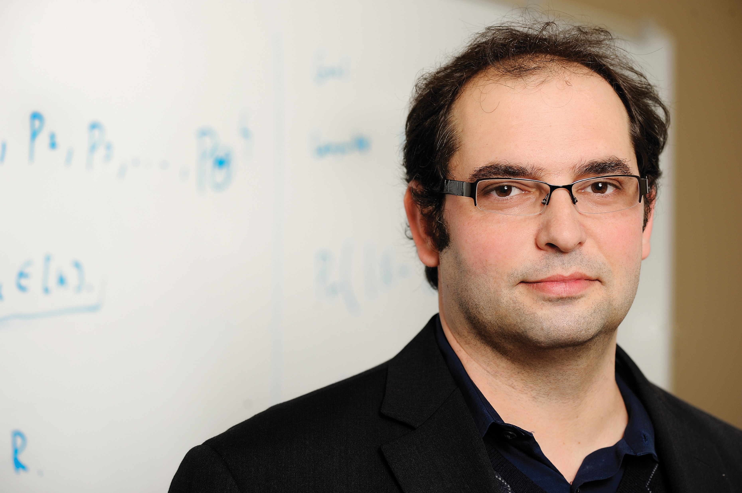


Private Data Stream Analysis for Universal Symmetric Norm Estimation
Vladimir Braverman
Joel Manning
Steven Wu
Samson Zhou

Slide 2
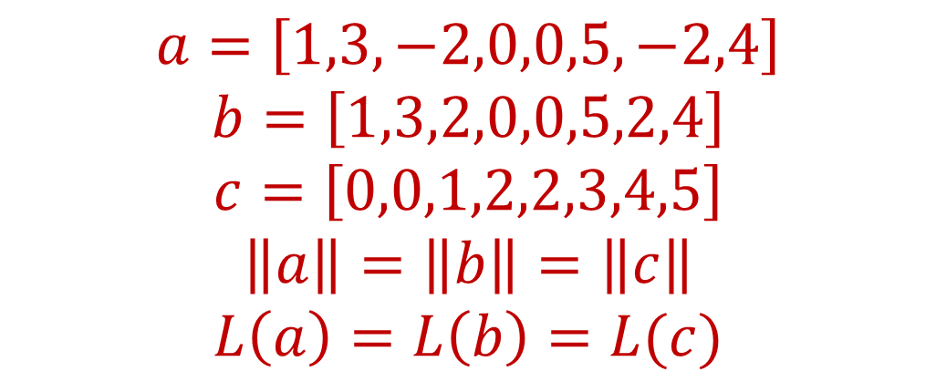
Symmetric Norms
A norm is symmetric if it is invariant under permutations and sign flips on an input frequency vector
$$a=\left[1,3,−2,0,0,5,−2,4\right]$$
$$b=\left[1,3,2,0,0,5,2,4\right]$$
$$c=\left[0,0,1,2,2,3,4,5\right]$$
$$\left\|a\right\|=\left\|b\right\|=\left\|c\right\|$$
$$L\left(a\right)=L\left(b\right)=L(c)$$

Slide 3
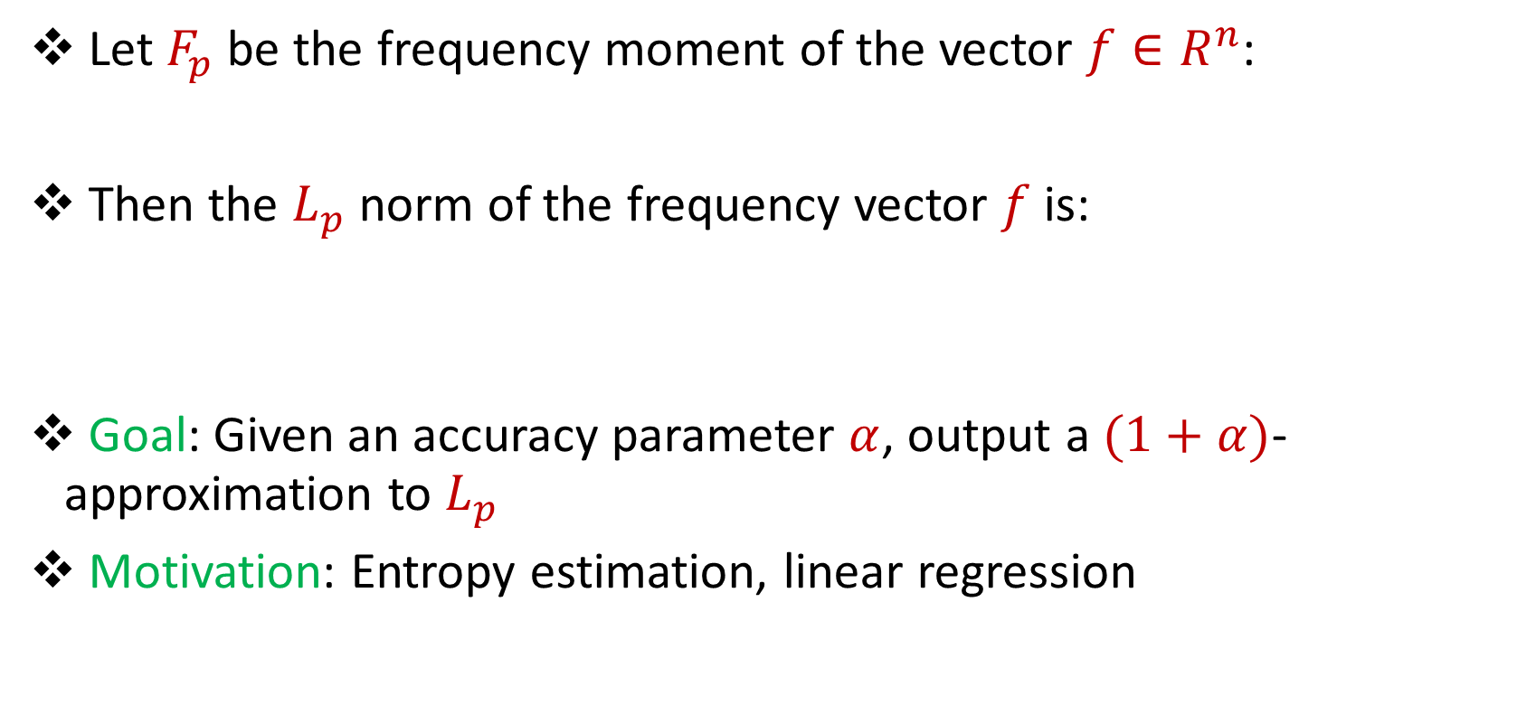
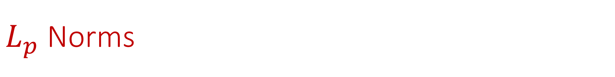

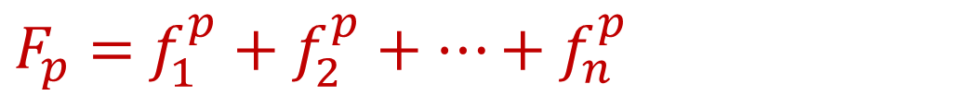
$L_{p}$ Norms
Let $F_{p}$ be the frequency moment of the vector $f∈R^{n}$:
Then the $L_{p}$ norm of the frequency vector $f$ is:
Goal: Given an accuracy parameter $α$, output a $(1+α)$-approximation to $L_{p}$
Motivation: Entropy estimation, linear regression
$F_{p}=$ $f_{1}^{p}+f_{2}^{p}+…+f_{n}^{p}$
$$L_{p}\left(f\right)={\left(F_{p}\left(f\right)\right)}^{1/p}$$

Slide 4
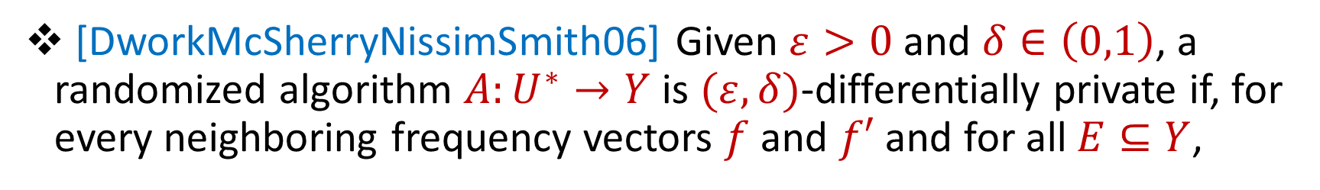
Differential Privacy
[DworkMcSherryNissimSmith06] Given $ε>0$and $δ∈\left(0,1\right)$, a randomized algorithm $A:U^{∗}→Y$ is $(ε,δ)$-differentially private if, for every neighboring frequency vectors $f$ and $f′$ and for all $E⊆Y$,
$$Pr\left[A\left(f\right)∈E\right]≤e^{ε}Pr\left[A\left(f^{′}\right)∈E\right]+δ$$

Slide 5
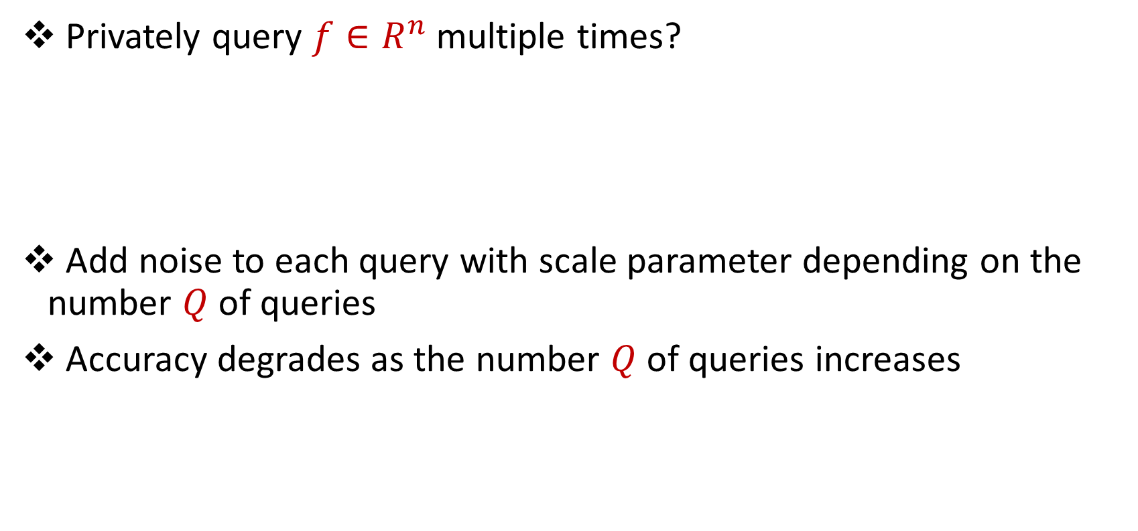
Multiple Privately Queries
Privately query $f∈R^{n}$ multiple times?
Add noise to each query with scale parameter depending on the number $Q$of queries
Accuracy degrades as the number $Q$of queries increases

Slide 6
Can we answer multiple queries without sacrificing accuracy?
“Beating the union bound”
“Avoid privacy analysis per algorithm”

Slide 7
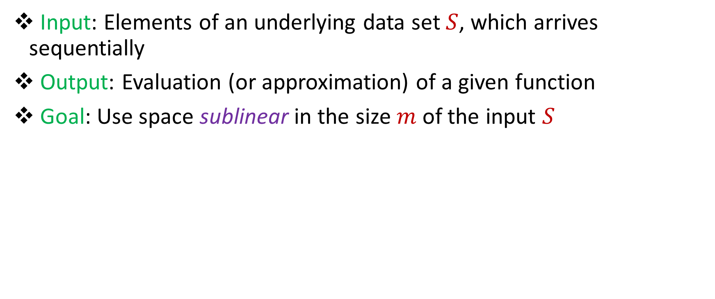
Streaming Model
Input: Elements of an underlying data set $S$, which arrives sequentially
Output: Evaluation (or approximation) of a given function
Goal: Use space sublinear in the size $m$of the input $S$
1 0 1 1 1 0 0 1
Notes:
Let’s start by breaking down each of the terms in the title. To understand the sliding window model, we first have to understand the streaming model of computation, in which elements of an underlying data set S, arrive sequentially and the goal is to evaluate or approximate some given function on this dataset, using space sublinear in S. In the sliding window model, only the W most recent updates form the underlying data set

Slide 8
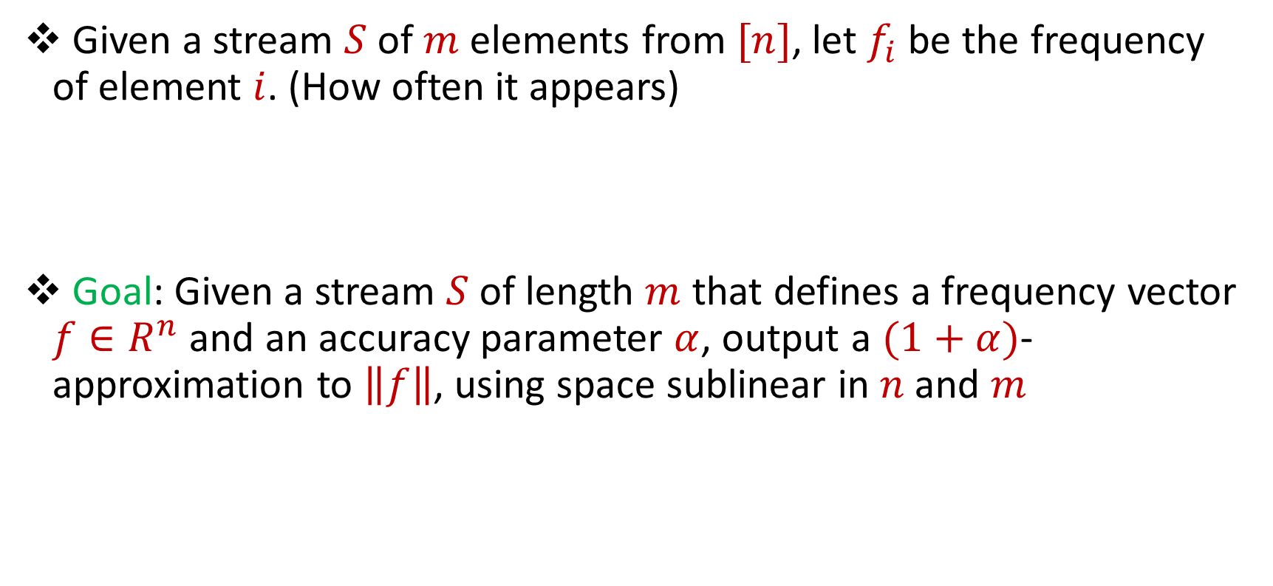
Symmetric Norms in the Streaming Model
Given a stream $S$ of $m$ elements from $[n]$, let $f_{i}$ be the frequency of element $i$. (How often it appears)
Goal: Given a stream $S$ of length $m$ that defines a frequency vector $f∈R^{n}$ and an accuracy parameter $α$, output a $(1+α)$-approximation to $\left\|f\right\|$, using space sublinear in $n$and $m$

Slide 9
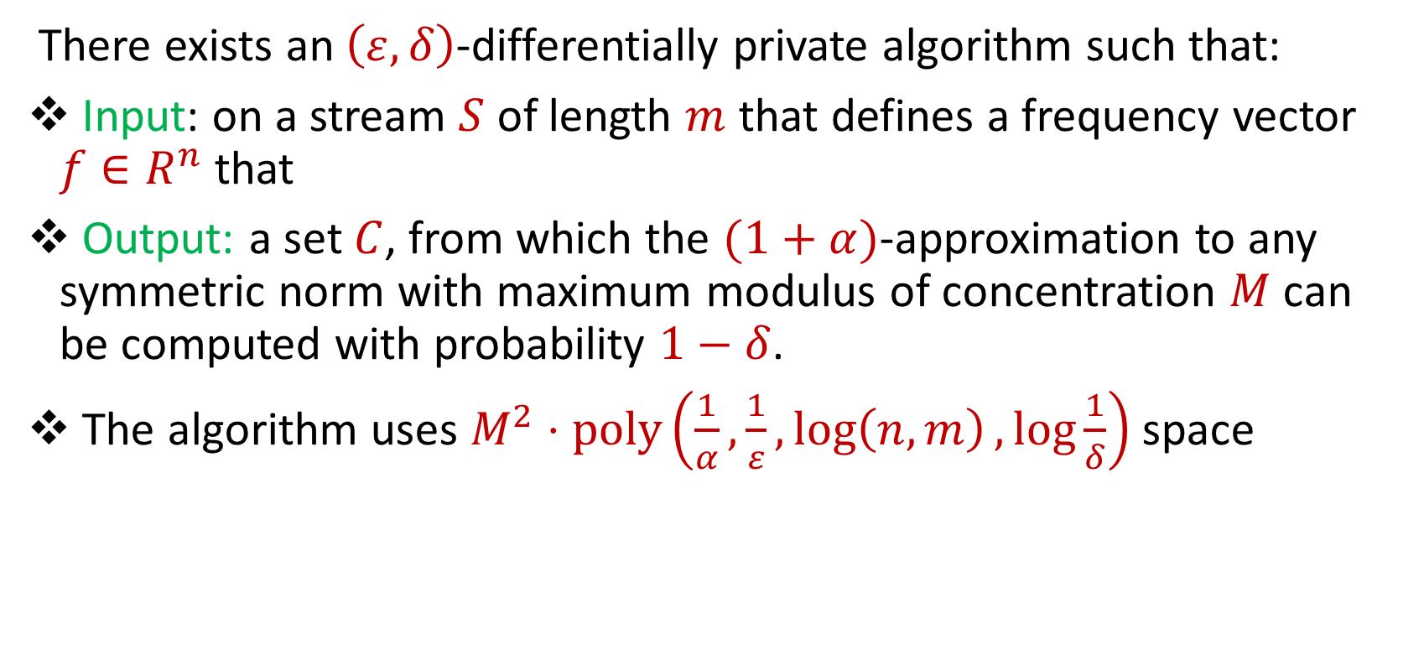
Our Result
There exists an $\left(ε,δ\right)$-differentially private algorithm such that:
Input: on a stream $S$ of length $m$ that defines a frequency vector $f∈R^{n}$ that
Output: a set $C$, from which the $(1+α)$-approximation to any symmetric norm with maximum modulus of concentration $M$ can be computed with probability $1−δ$.
The algorithm uses $M^{2}⋅poly\left(\frac{1}{α},\frac{1}{ε},\log\left(n,m\right),\log{\frac{1}{δ}}\right)$ space

Slide 10
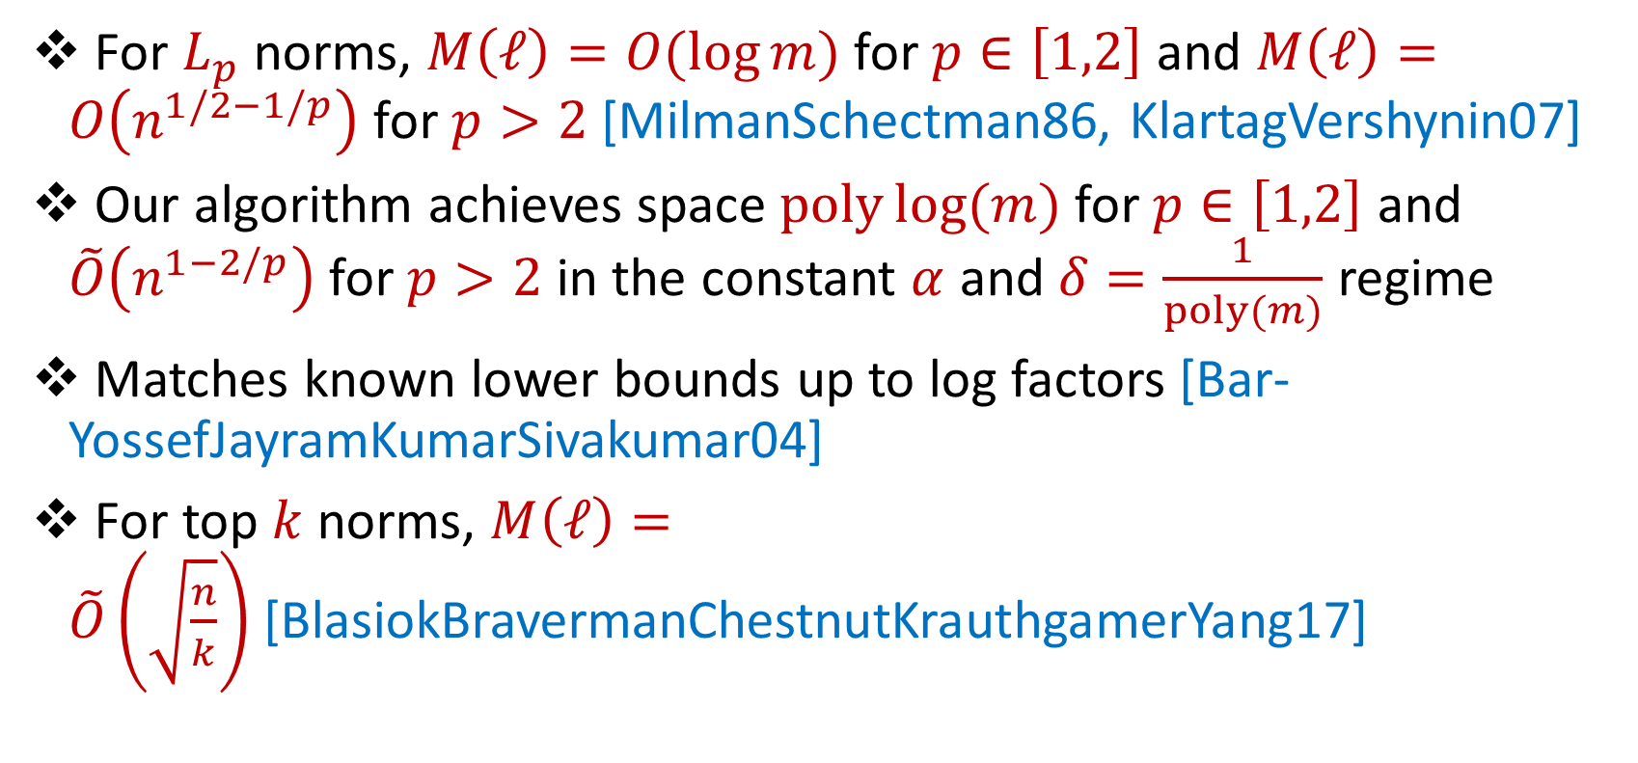
Applications
For $L_{p}$ norms, $M\left(ℓ\right)=O(\log{m)}$for $p∈\left[1,2\right]$ and $M\left(ℓ\right)=O\left(n^{1/2−1/p}\right)$for $p>2$ [MilmanSchectman86, KlartagVershynin07]
Our algorithm achieves space $poly\log{(m)}$for $p∈\left[1,2\right]$ and $\tilde{O}\left(n^{1−2/p}\right)$for $p>2$ in the constant $α$ and $δ=\frac{1}{poly(m)}$ regime
Matches known lower bounds up to log factors [Bar-YossefJayramKumarSivakumar04]
For top $k$norms, $M\left(ℓ\right)=\tilde{O}\left(\sqrt{\frac{n}{k}}\right)$[BlasiokBravermanChestnutKrauthgamerYang17]

Slide 11
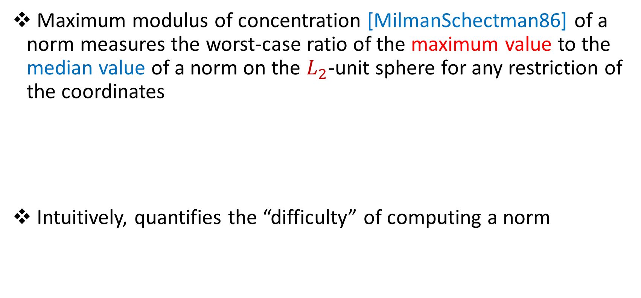
Maximum Modulus of Concentration
Maximum modulus of concentration [MilmanSchectman86] of a norm measures the worst-case ratio of the maximum value to the median value of a norm on the $L_{2}$-unit sphere for any restriction of the coordinates
Intuitively, quantifies the “difficulty” of computing a norm

Slide 12
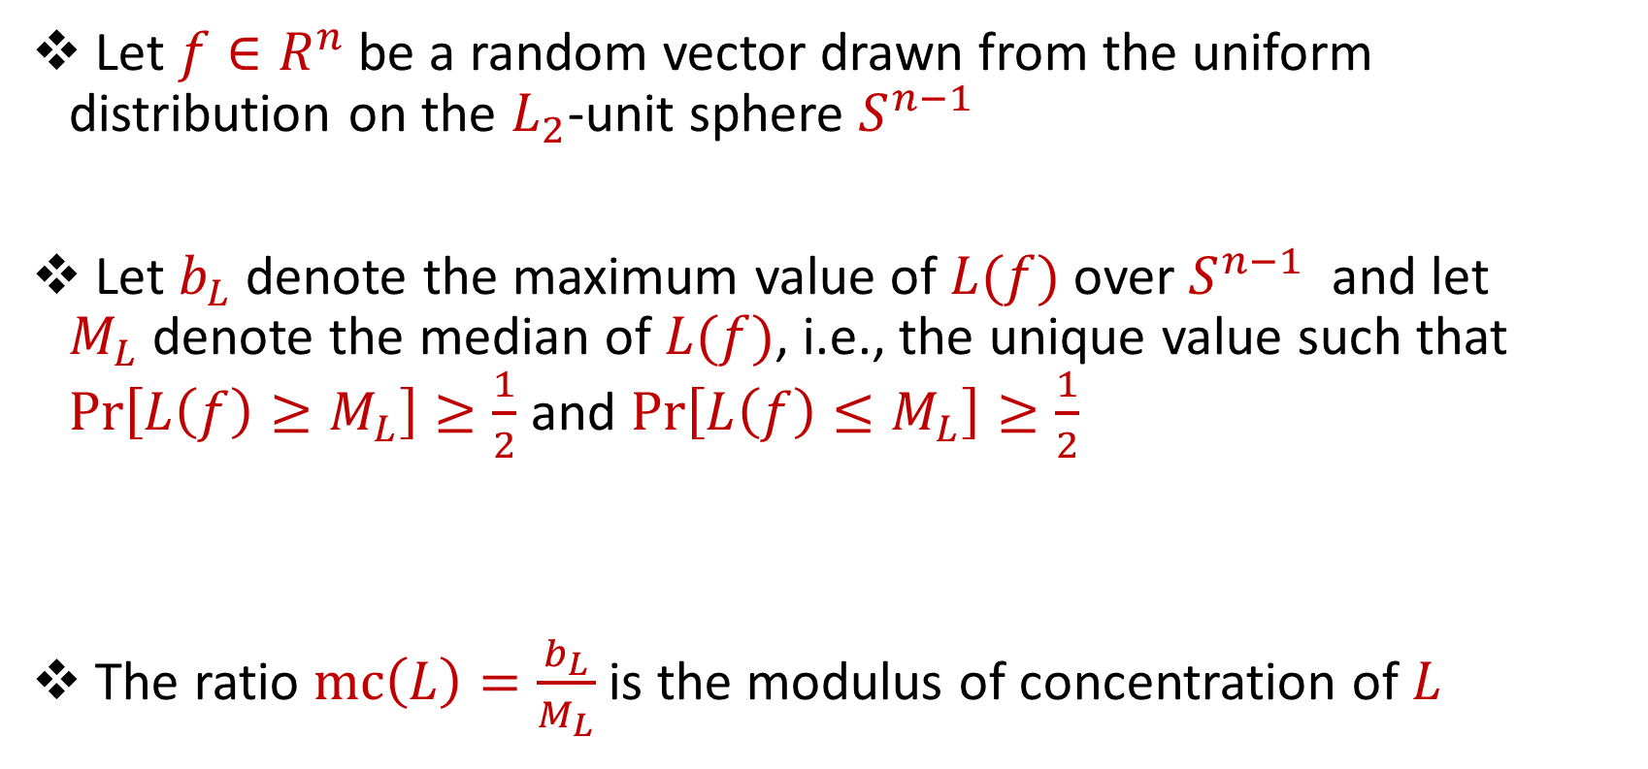
Modulus of Concentration
Let $f∈R^{n}$ be a random vector drawn from the uniform distribution on the $L_{2}$-unit sphere $S^{n−1}$
Let $b_{L}$ denote the maximum value of $L(f)$ over $S^{n−1}$ and let $M_{L}$denote the median of $L(f)$, i.e., the unique value such that $Pr\left[L\left(f\right)≥M_{L}\right]≥\frac{1}{2}$ and $Pr\left[L\left(f\right)≤M_{L}\right]≥\frac{1}{2}$
The ratio $mc\left(L\right)=\frac{b_{L}}{M_{L}}$ is the modulus of concentration of $L$

Slide 13
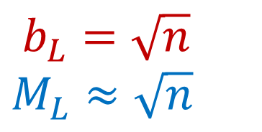
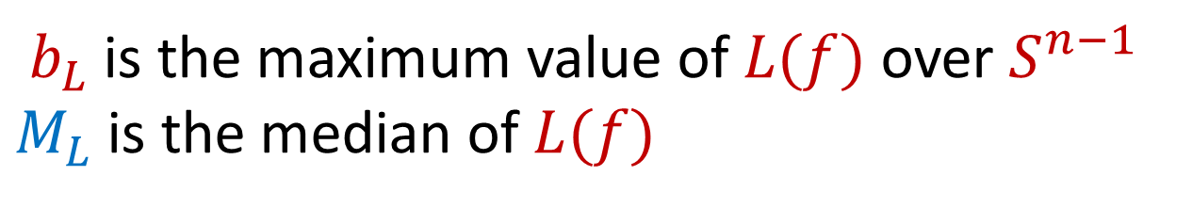
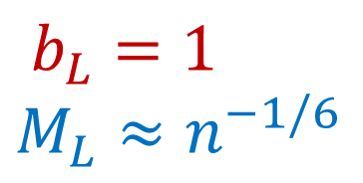
Modulus of Concentration
$b_{L}$ is the maximum value of $L(f)$ over $S^{n−1}$
$M_{L}$is the median of $L(f)$
$b_{L}=\sqrt{n}$
$M_{L}≈\sqrt{n}$
$b_{L}=1$
$M_{L}≈n^{−1/6}$

Slide 14
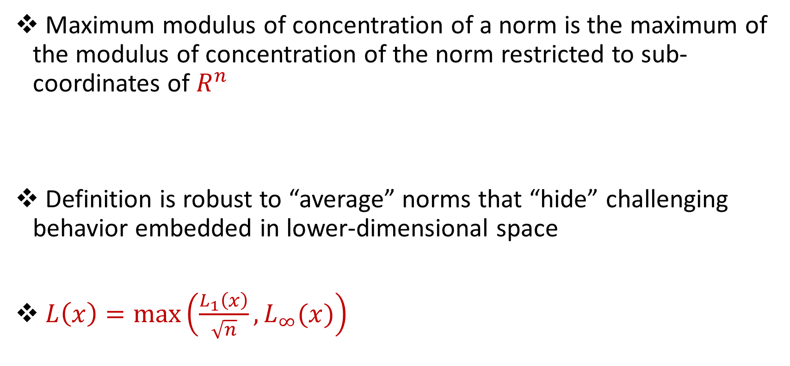
Maximum Modulus of Concentration
Maximum modulus of concentration of a norm is the maximum of the modulus of concentration of the norm restricted to sub-coordinates of $R^{n}$
Definition is robust to “average” norms that “hide” challenging behavior embedded in lower-dimensional space
$L\left(x\right)=\max\left(\frac{L_{1}\left(x\right)}{\sqrt{n}},L_{∞}(x)\right)$

Slide 15
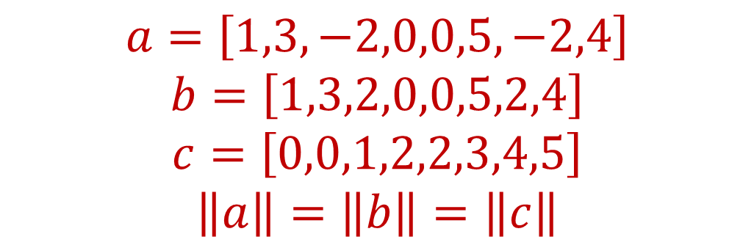
Symmetric Norms
A norm is symmetric if it is invariant under permutations and sign flips on an input frequency vector
$$a=\left[1,3,−2,0,0,5,−2,4\right]$$
$$b=\left[1,3,2,0,0,5,2,4\right]$$
$$c=\left[0,0,1,2,2,3,4,5\right]$$
$$\left\|a\right\|=\left\|b\right\|=\left\|c\right\|$$

Slide 16
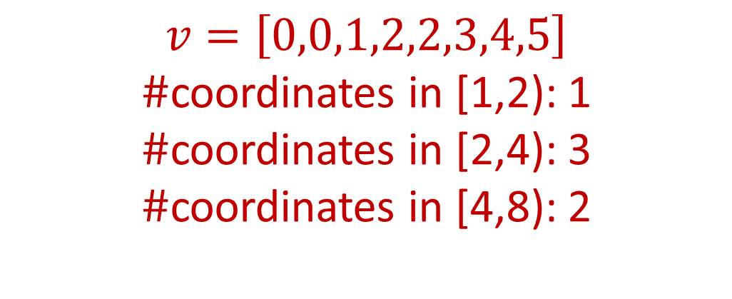
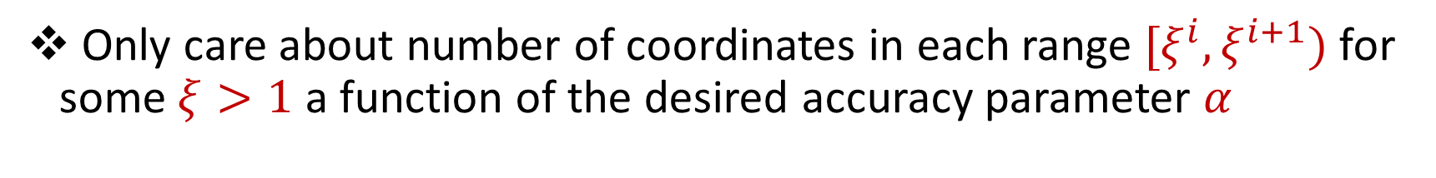
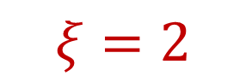
Approximating Symmetric Norms
Only care about number of coordinates in each range $[ξ^{i},ξ^{i+1})$ for some $ξ>1$ a function of the desired accuracy parameter $α$
$$v=\left[0,0,1,2,2,3,4,5\right]$$
$\#$coordinates in [1,2): 1
$\#$coordinates in [2,4): 3
$\#$coordinates in [4,8): 2
$$ξ=2$$

Slide 17
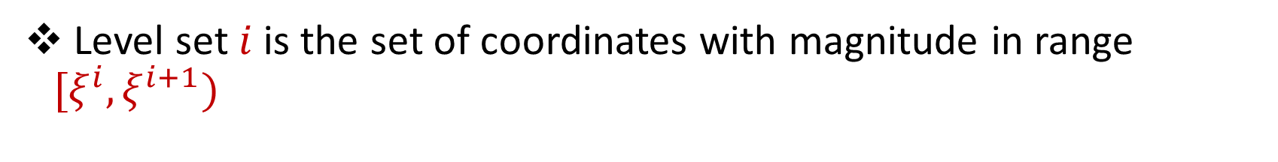
Level Sets
Level set $i$is the set of coordinates with magnitude in range $[ξ^{i},ξ^{i+1})$
$$v=\left[0,0,1,2,2,3,4,5\right]$$
Level set 0
Level set 2
Level set 1

Slide 18

Contribution of Level Sets
The contribution of the level set is the “amount” the level set contributes to the norm of the entire frequency vector
$$v=\left[0,0,1,2,2,3,4,5\right]$$
$$v′=\left[0,0,0,2,2,3,0,0\right]$$
Level set 1

Slide 19
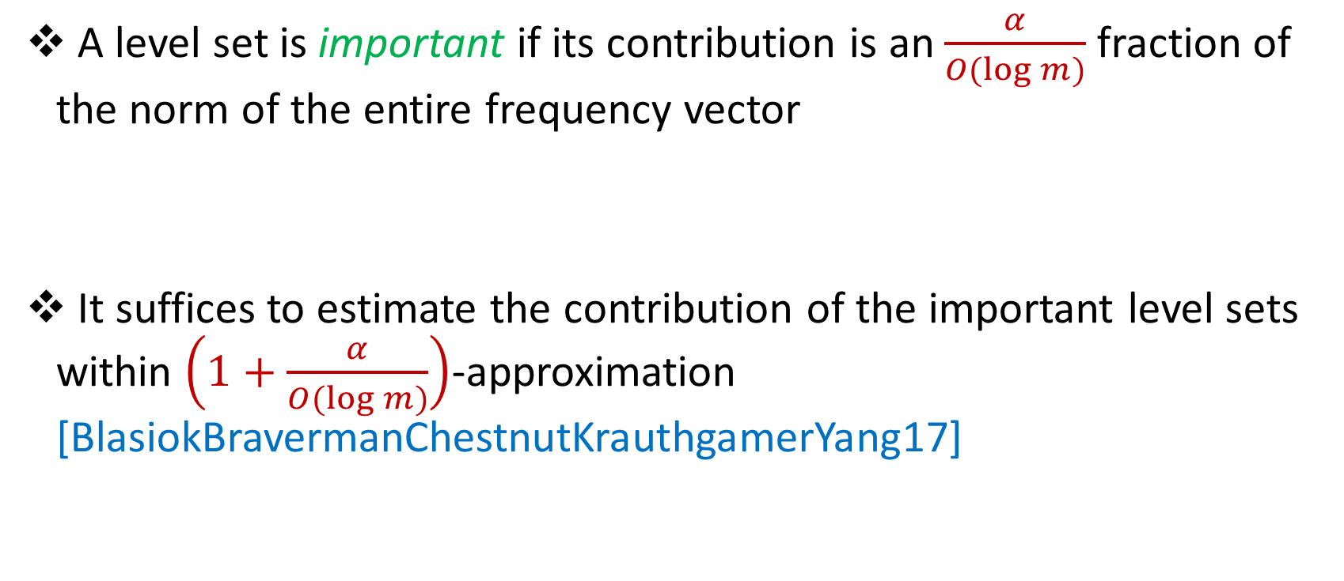
Important Level Sets
A level set is important if its contribution is an $\frac{α}{O(\log{m)}}$fraction of the norm of the entire frequency vector
It suffices to estimate the contribution of the important level sets within $\left(1+\frac{α}{O(\log{m)}}\right)$-approximation [BlasiokBravermanChestnutKrauthgamerYang17]

Slide 20
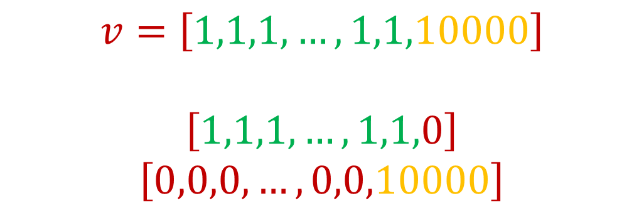
Important Level Sets
Intuition: Important level sets must either have large magnitude coordinates or a large number of coordinates
How to privately release important level sets?
$$v=\left[1,1,1,…,1,1,10000\right]$$
$$\left[1,1,1,…,1,1,0\right]$$
$$\left[0,0,0,…,0,0,10000\right]$$

Slide 21
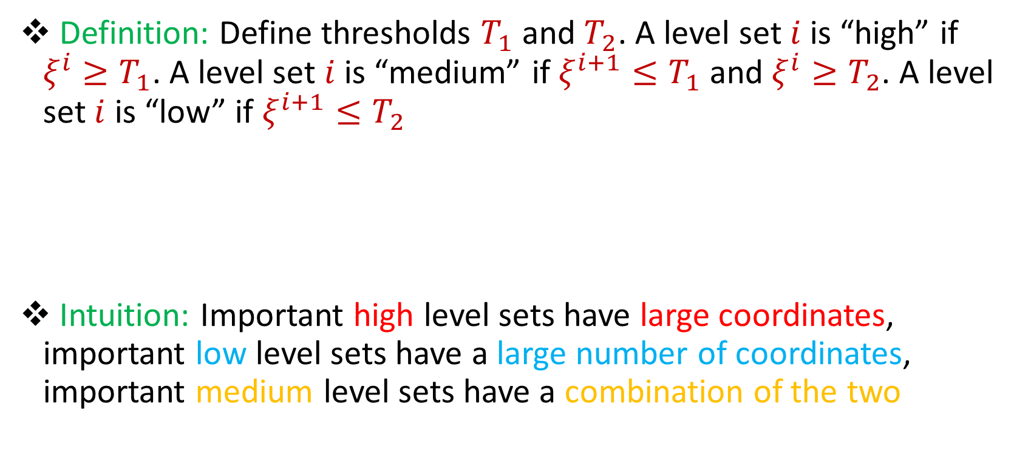
Important Level Sets
Definition: Define thresholds $T_{1}$ and $T_{2}$. A level set $i$is “high” if $ξ^{i}≥T_{1}$. A level set $i$ is “medium” if $ξ^{i+1}≤T_{1}$and $ξ^{i}≥T_{2}$. A level set $i$ is “low” if $ξ^{i+1}≤T_{2}$
Intuition: Important high level sets have large coordinates, important low level sets have a large number of coordinates, important medium level sets have a combination of the two

Slide 22
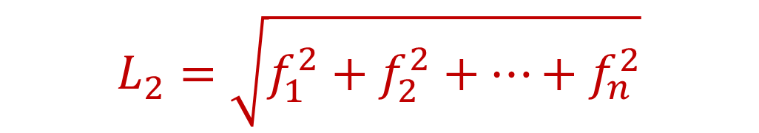
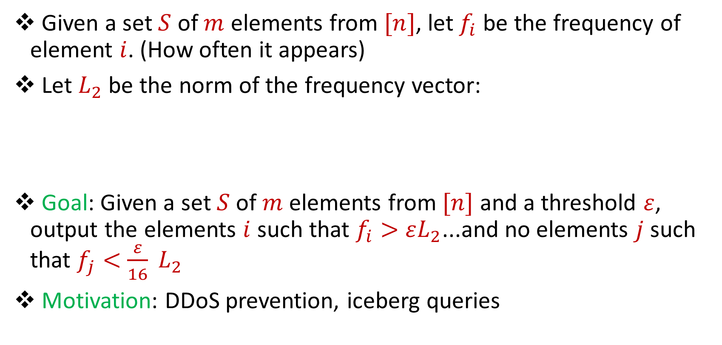
Heavy-Hitters
Given a set $S$ of $m$ elements from $[n]$, let $f_{i}$ be the frequency of element $i$. (How often it appears)
Let $L_{2}$ be the norm of the frequency vector:
Goal: Given a set $S$ of $m$ elements from $[n]$ and a threshold $ε$, output the elements $i$ such that $f_{i}>$ $εL_{2}$...and no elements $j$ such that $f_{j}<$ $\frac{ε}{16} L_{2}$
Motivation: DDoS prevention, iceberg queries
$$L_{2}=\sqrt{f_{1}^{2}+f_{2}^{2}+…+f_{n}^{2}}$$

Slide 23
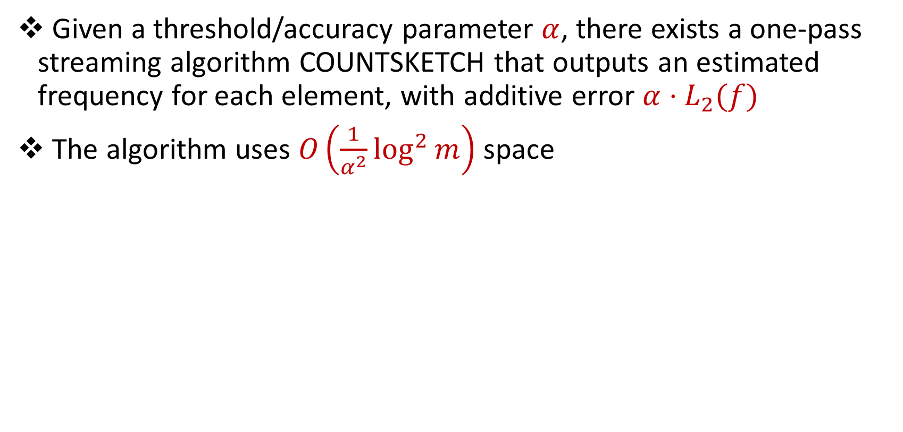
CountSketch
Given a threshold/accuracy parameter $α$, there exists a one-pass streaming algorithm COUNTSKETCH that outputs an estimated frequency for each element, with additive error $α⋅L_{2}(f)$
The algorithm uses $O\left(\frac{1}{α^{2}}\log^{2}{m}\right)$ space

Slide 24

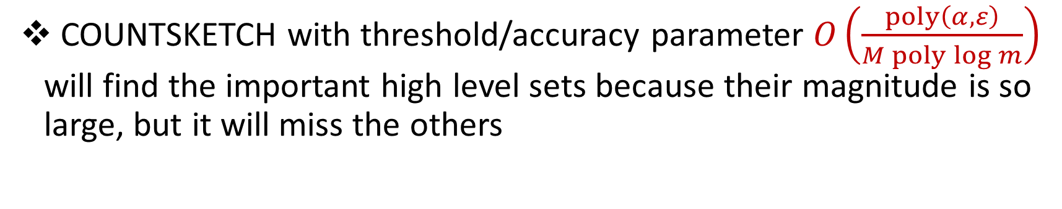
CountSketch
COUNTSKETCH with threshold/accuracy parameter $O\left(\frac{poly\left(α,ε\right)}{M poly\log{m}}\right)$ will find the important high level sets because their magnitude is so large, but it will miss the others
$$c=\left[1,1,1,…,1,1,10000\right]$$
$$\left[1,1,1,…,1,1,0\right]$$
$$\left[0,0,0,…,0,0,10000\right]$$

Slide 25
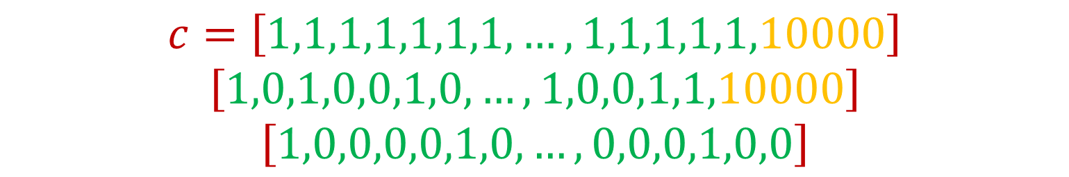
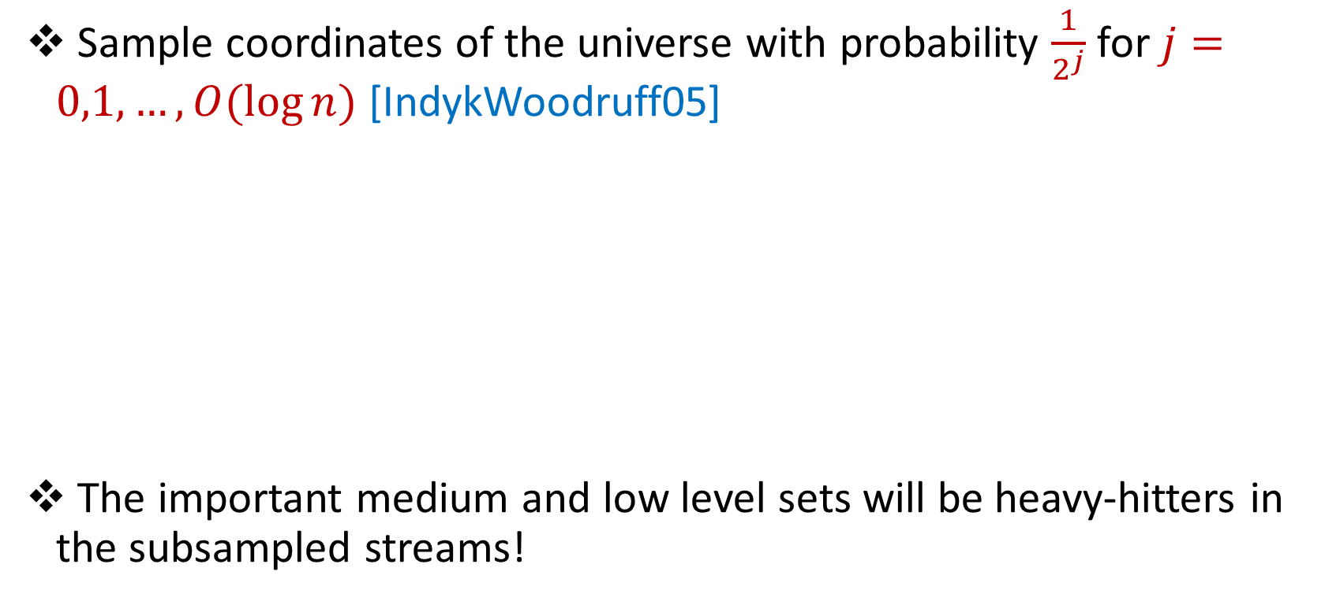
Subsampling the Universe
Sample coordinates of the universe with probability $\frac{1}{2^{j}}$ for $j=0,1,…,O(\log{n)}$ [IndykWoodruff05]
The important medium and low level sets will be heavy-hitters in the subsampled streams!
$$c=\left[1,1,1,1,1,1,1,…,1,1,1,1,1,10000\right]$$
$$\left[1,0,1,0,0,1,0,…,1,0,0,1,1,10000\right]$$
$$\left[1,0,0,0,0,1,0,…,0,0,0,1,0,0\right]$$

Slide 26

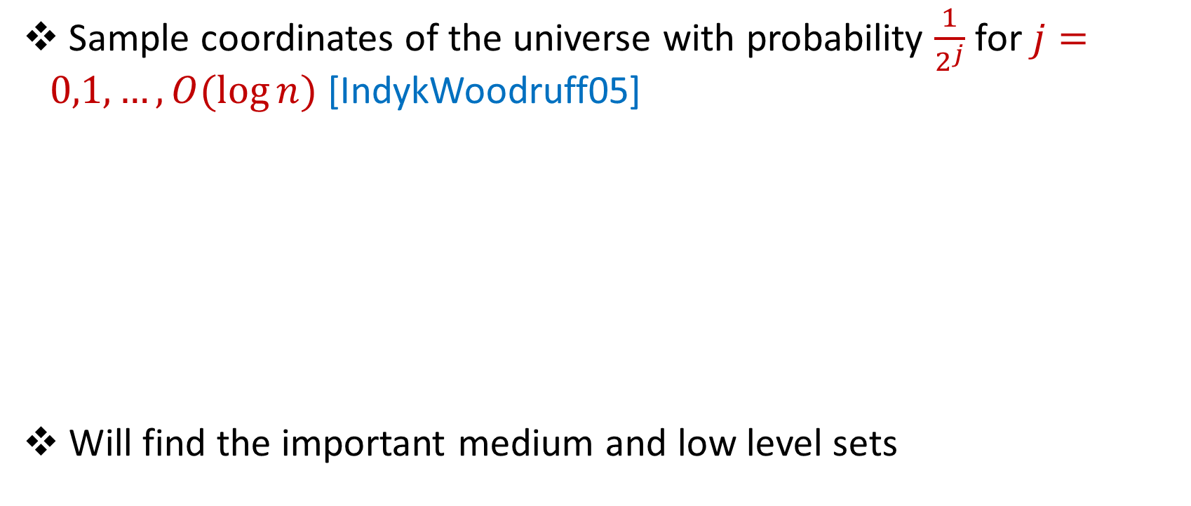
Subsampling the Universe
Sample coordinates of the universe with probability $\frac{1}{2^{j}}$ for $j=0,1,…,O(\log{n)}$ [IndykWoodruff05]
Will find the important medium and low level sets
$$c=\left[1,1,1,1,1,1,1,…,1,1,1,1,1,10000\right]$$
$$\left[1,0,1,0,0,1,0,…,1,0,0,1,1,10000\right]$$
$$\left[1,0,0,0,0,1,0,…,0,0,0,1,0,0\right]$$

Slide 27
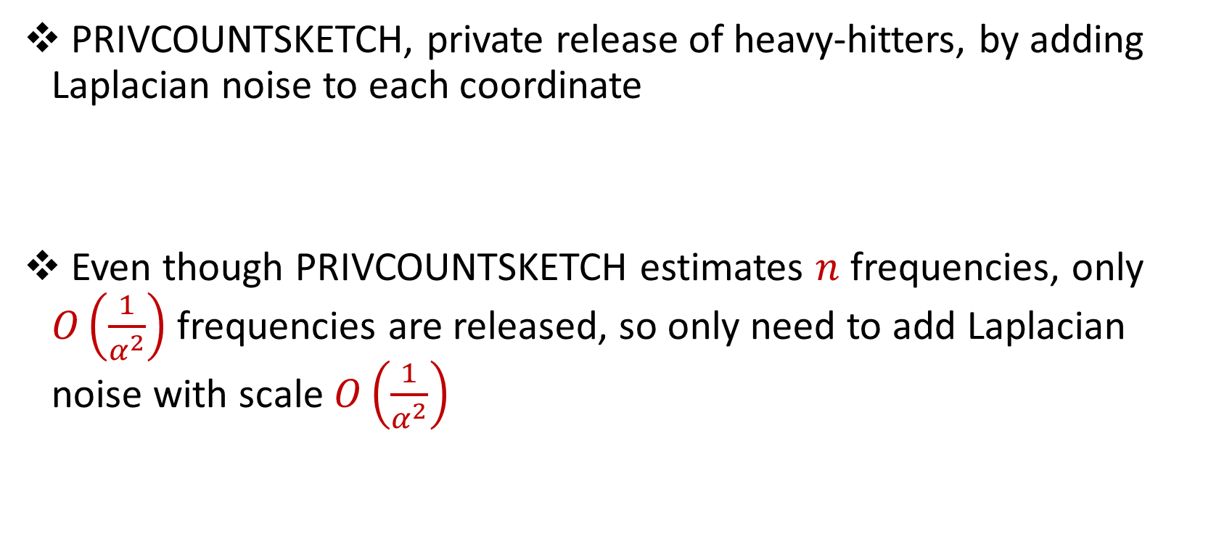
Towards Privacy
PRIVCOUNTSKETCH, private release of heavy-hitters, by adding Laplacian noise to each coordinate
Even though PRIVCOUNTSKETCH estimates $n$ frequencies, only $O\left(\frac{1}{α^{2}}\right)$ frequencies are released, so only need to add Laplacian noise with scale $O\left(\frac{1}{α^{2}}\right)$

Slide 28
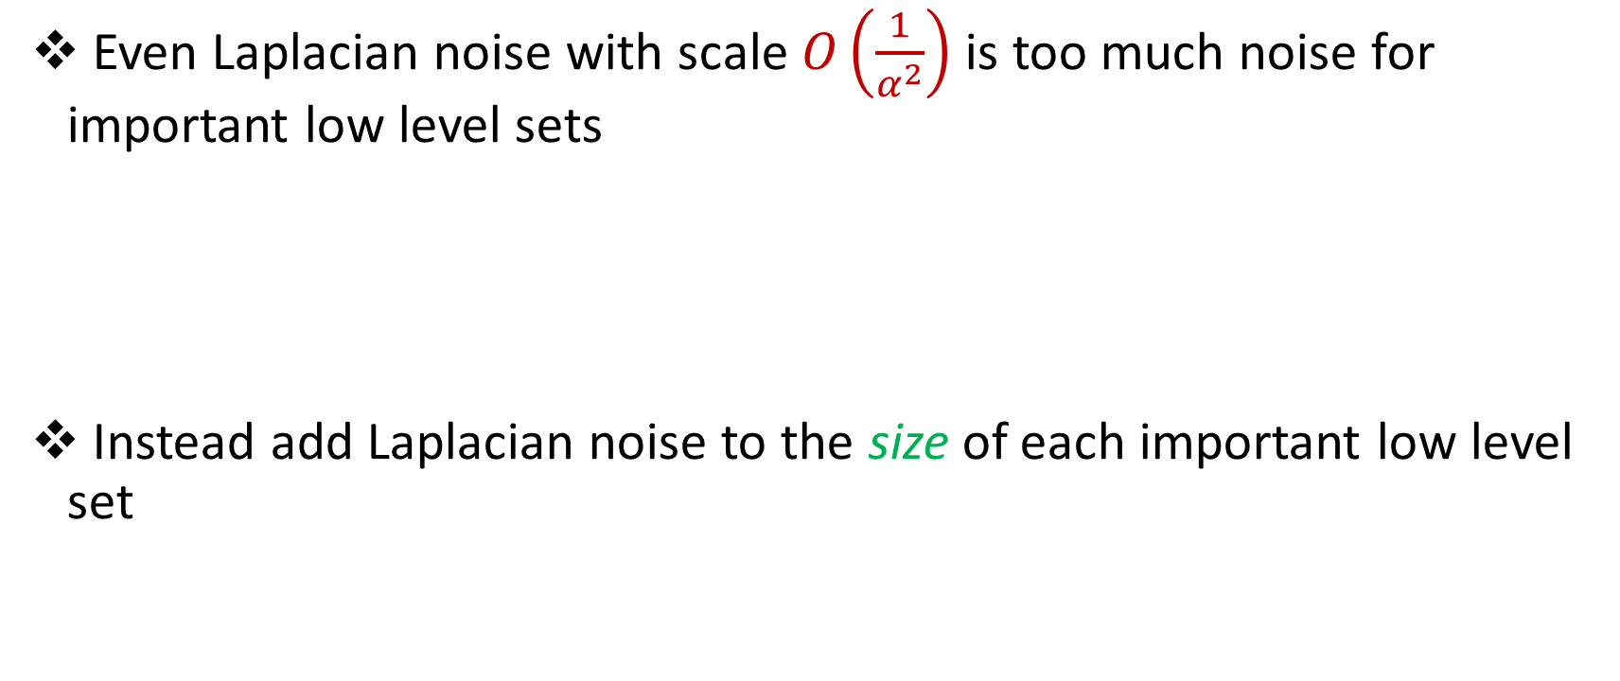
Towards Privacy
Even Laplacian noise with scale $O\left(\frac{1}{α^{2}}\right)$ is too much noise for important low level sets
Instead add Laplacian noise to the size of each important low level set

Slide 29
Important High Level Sets
PRIVCOUNTSKETCH
Private magnitudes of coordinates
Important Medium Level Sets
Subsampling
PRIVCOUNTSKETCH + Rescaling level set sizes
Private sizes of level sets
Important Low Level Sets
Subsampling
Adding noise to level set sizes
Private sizes of level sets

Slide 30
Additional Challenges
Privately identify coordinates for each level set → Two instances of PRIVCOUNTSKETCH
Classification error for each level set from privacy noise → Thresholds are robust for high, medium, and low important levels
Classification error for each level set from frequency estimation → Randomly choose boundaries of each level set

Slide 31

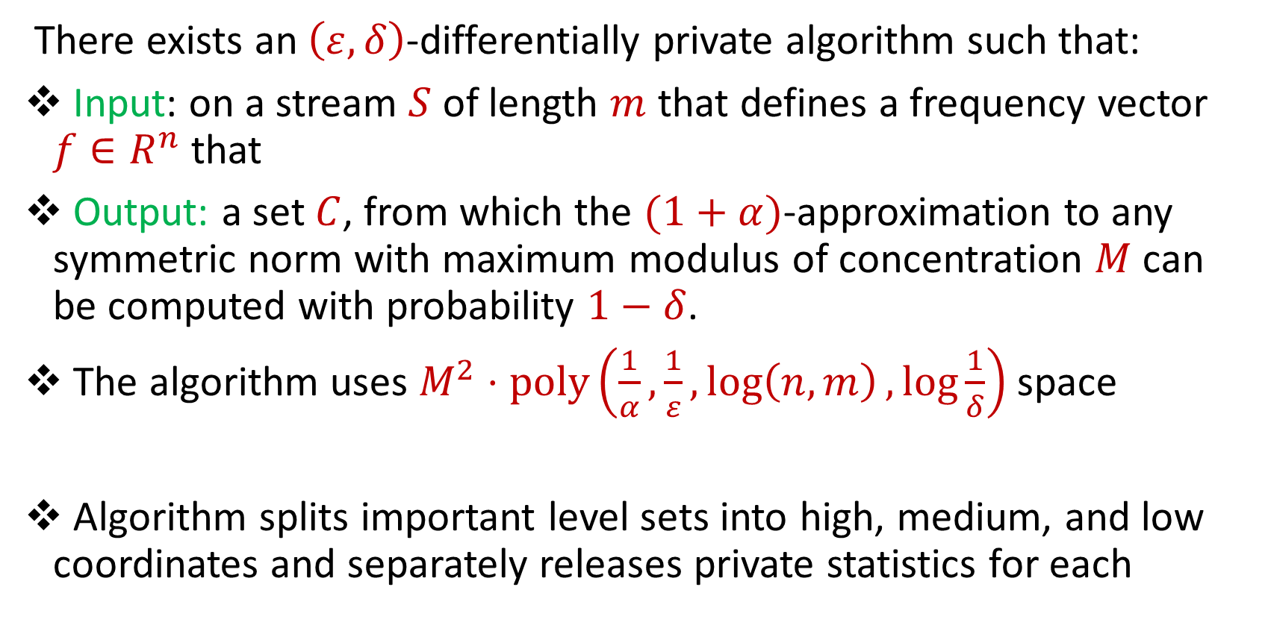
Summary
There exists an $\left(ε,δ\right)$-differentially private algorithm such that:
Input: on a stream $S$ of length $m$ that defines a frequency vector $f∈R^{n}$ that
Output: a set $C$, from which the $(1+α)$-approximation to any symmetric norm with maximum modulus of concentration $M$ can be computed with probability $1−δ$.
The algorithm uses $M^{2}⋅poly\left(\frac{1}{α},\frac{1}{ε},\log\left(n,m\right),\log{\frac{1}{δ}}\right)$ space
Algorithm splits important level sets into high, medium, and low coordinates and separately releases private statistics for each

